Slide 1
CSG523/ Desain dan Analisis Algoritma
Backtracking
Intelligence, Computing, Multimedia (ICM)

Slide 2
Graph Operations
Traversal (search)
Visit each node in graph exactly once
Usually perform computation at each node
Two approaches
Breadth first search (BFS)
Depth first search (DFS)
CSG523/ Desain dan Analisis Algoritma

Slide 3
Breadth-first Search (BFS)
Approach
Visit all neighbors of node first
View as series of expanding circles
Keep list of nodes to visit in queue
Example traversal
n
a, c, b
e, g, h, i, j
d, f
CSG523/ Desain dan Analisis Algoritma

Slide 4
Example traversals
1
1
1
2
3
3
2
2
3
4
5
6
6
5
4
5
6
4
7
7
7
Left to right
Right to left
Random
CSG523/ Desain dan Analisis Algoritma

Slide 5
Depth-first Search (DFS)
Approach
Visit all nodes on path first
Backtrack when path ends
Keep list of nodes to visit in a stack
Example traversal
n, a, b, c, d, …
f …
CSG523/ Desain dan Analisis Algoritma

Slide 6
Example traversals
1
1
1
2
6
4
2
2
6
3
5
7
6
5
3
4
3
7
4
7
5
Left to right
Right to left
Random
CSG523/ Desain dan Analisis Algoritma

Slide 7
What is backtracking?
It is a systematic search strategy of the state-space of combinatorial problems
It is mainly used to solve problems which ask for finding elements of a set which satisfy some restrictions. Many problems which can be solved by backtracking have the following general form:
“ Find S subset of A₁ x A₂ x … x A_{n} (A_{k} – finite sets) such that each element s=(s₁,s₂,…,s_{n}) satisfy some restrictions”
Example: generating all permutations of {1,2,…,n}
A_{k} = {1,2,…,n} for all k
s_{i} <> s_{j} for all i<>j
CSG523/ Desain dan Analisis Algoritma

Slide 8
What is backtracking?
Basic ideas:
each partial solution is evaluated in order to establish if it is promising (a promising solution could lead to a final solution while a non-promising one does not satisfy the partial restrictions induced by the problem restriction)
if all possible values for a component do not lead to a promising partial solution then one come back to the previously component and try another value for it
backtracking implicitly constructs a state space tree:
The root corresponds to an initial state (before the search for a solution begins)
An internal node corresponds to a promising partial solution
An external node (leaf) corresponds to either to a non-promising partial solution or to a final solution
CSG523/ Desain dan Analisis Algoritma

Slide 9
Example: state space tree for permutations generation
(*,*,*)
(1,*,*)
(2,*,*)
(3,*,*)
(1,1,*)
(1,2,*)
(1,3,*)
(2,1,*)
(2,2,*)
(2,3,*)
(3,1,*)
(3,2,*)
(3,3,*)
(1,2,3)
(1,3,2)
(2,1,3)
(2,3,1)
(3,1,2)
(3,2,1)
CSG523/ Desain dan Analisis Algoritma

Slide 10
Specific Example: The N-Queens Problem
N-queens problem: Place N queens on an N x N grid (chess board) so that no more than 1 queen is on any vertical, diagonal, or horizontal line
(i.e., no queens can attack each other in chess).
If a queen can attack another, it is called a “conflict”.
CSG523/ Desain dan Analisis Algoritma

Slide 11
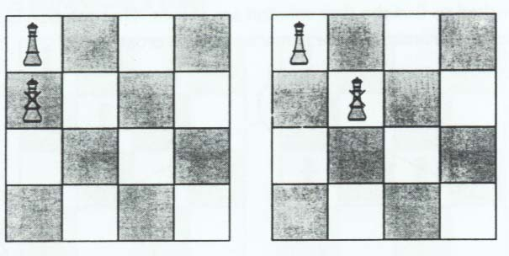
The 4 Queens Problem
CSG523/ Desain dan Analisis Algoritma

Slide 12
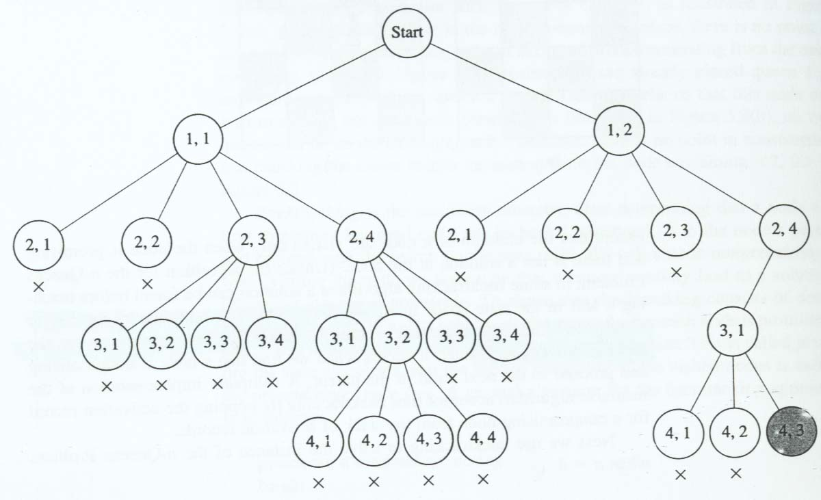
CSG523/ Desain dan Analisis Algoritma

Slide 13
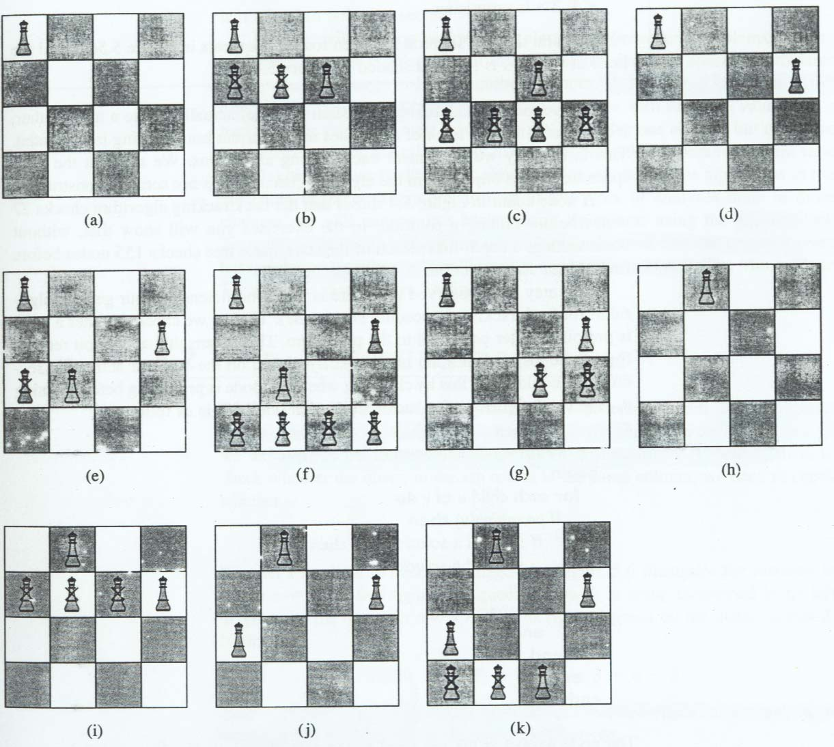
The 4 Queens Problem
CSG523/ Desain dan Analisis Algoritma

Slide 14
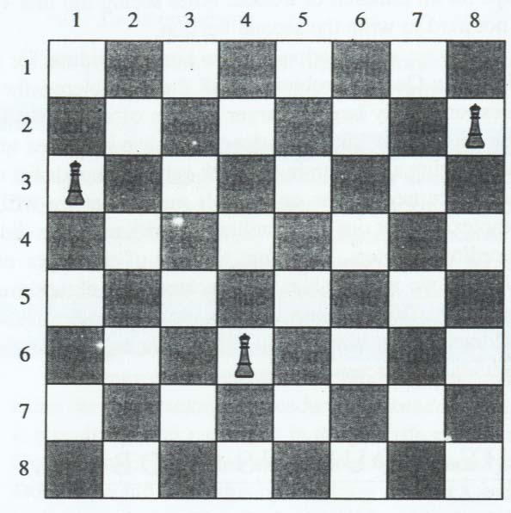
How to check the diagonal/column ?
CSG523/ Desain dan Analisis Algoritma

Slide 15
Let col(i) be the column where the queen in the ith row is located.
Check column → col(i) = col(k)
Check diagonal → col(i) – col(k) = i-k or col(i) – col(k) = k – i
Examples. In the figure, the queen in row 6 is being threatened in its left diagonal by the queen in row 3, and in its right diagonal by the queen in row 2.
col(6) – col(3)= 4 – 1= 3 = 6 – 3
col(6) – col(2)= 4 – 8= -4 =2 – 6
CSG523/ Desain dan Analisis Algoritma

Slide 16
Backtracking algorithm for the n queens
Procedure queens(i:index);
Var j:index;
Begin
if promising(i) then
if i=n then
write(col[1] through col[n])
else
for j:=1 to n do
col[i+1]:=j;
queens(i+1)
end
end
end
End;
CSG523/ Desain dan Analisis Algoritma

Slide 17
Backtracking algorithm for the n queens
function promising(i:index):boolean;
Var k:index;
Begin
k:=1;
promising:=true;
while k<i and promising do
if col[i]=col[k] or abs(col[i]-col[k])=i-k then
promising:=false
end
k:=k+1
end
End;
CSG523/ Desain dan Analisis Algoritma

Slide 18
Backtracking algorithm for the n queens
Top level call to queens is
queens(0);
Total number of nodes:
CSG523/ Desain dan Analisis Algoritma

Slide 19
The 8 Queens Problem
Conflict!
So far so good…
Problem: place 8 queens on a chess board
so that they can not attack each other.
CSG523/ Desain dan Analisis Algoritma

Slide 20
Sequence
of operators
Start State
Goal State
Sequence
of operators
Conflict!
The search strategy indicates which operators to perform
CSG523/ Desain dan Analisis Algoritma

Slide 21
Two Simple Search Strategies
Depth-First Search
This is like a pre-order traversal.
Start with a blank board.
Our actions are to add a queen and recurse.
Prune if conflicts occur.
Greedy Search
Start with a possible board with N queens.
Our actions are to move the queens.
Attempt to minimize the number of conflicts.
CSG523/ Desain dan Analisis Algoritma

Slide 22
Depth-First Search on the 8 Queens
Blue = Conflict!
prune
This is
a search
tree!
CSG523/ Desain dan Analisis Algoritma

Slide 23
Choices in Representation
Your choice of representation is crucial to your success.
It must have as few states as possible.
But it still must contain the goal state.
The goal state must be “reachable” from the start state (i.e., the goal state can be reached by applying operators to the start state).
CSG523/ Desain dan Analisis Algoritma

Slide 24
Representation #1 (very naïve):
Initialize every square with 0’s (representing no queens).
A queen is represented with a 1. Allow a choice of 0 or 1 for every
square. While searching this space, prune states that violate constraints.
Size of the search space: 2^{N*N} WHY?
If N=10, this is approximately 10³⁰
0 | 1 | 1 | 0
0 | 0 | 0 | 0
1 | 1 | 0 | 1
1 | 0 | 1 | 1
0 | 0 | 1 | 0
1 | 0 | 0 | 0
0 | 0 | 0 | 1
0 | 1 | 0 | 0
Possible State
Goal State
CSG523/ Desain dan Analisis Algoritma

Slide 25
Representation #2 (captures the constraint of N queens):
Initialize all squares with 0s. Put down N 1s on the board. While searching
this space, prune states that violate constraints.
Size of the search space:
If N=10, this is approximately 10¹⁴
0 | 1 | 1 | 0
0 | 0 | 0 | 0
0 | 1 | 0 | 0
0 | 0 | 0 | 1
0 | 0 | 1 | 0
1 | 0 | 0 | 0
0 | 0 | 0 | 1
0 | 1 | 0 | 0
Possible State
Goal State
CSG523/ Desain dan Analisis Algoritma

Slide 26
Representation #3 (captures the N queens and column constraints):
Use a vector with each entry corresponding to the column number. The value
of the entry is the row number. While searching this space, prune states
that violate row and diagonal constraints.
Size of the search space: N^{N} WHY?
If N=10, this is 10¹⁰
[ 3 2 3 1 ]
0 | 0 | 0 | 1
0 | 1 | 0 | 0
1 | 0 | 1 | 0
0 | 0 | 0 | 0
0 | 0 | 1 | 0
1 | 0 | 0 | 0
0 | 0 | 0 | 1
0 | 1 | 0 | 0
Possible State
Goal State
CSG523/ Desain dan Analisis Algoritma

Slide 27
Representation #4 (captures the N queens and row and column constraints):
Use a vector with each entry corresponding to the column number. The value
of the entry is the row number. Don’t allow duplicate entries.
While searching this space, prune states that violate diagonal constraints.
Size of the search space: N! WHY?
If N=10, this is approximately 10⁶
[ 3 2 4 1 ]
0 | 0 | 0 | 1
0 | 1 | 0 | 0
1 | 0 | 0 | 0
0 | 0 | 1 | 0
0 | 0 | 1 | 0
1 | 0 | 0 | 0
0 | 0 | 0 | 1
0 | 1 | 0 | 0
Possible State
Goal State
CSG523/ Desain dan Analisis Algoritma

Slide 28
Depth-First Search (representation #3)
1 0 0 0 0 0 0 0
0 0 0 0 0 0 0 0
Blue = Conflict!
2 0 0 0 0 0 0 0
prune
1 1 0 0 0 0 0 0
1 2 0 0 0 0 0 0
1 3 0 0 0 0 0 0
1 4 0 0 0 0 0 0
1 5 0 0 0 0 0 0
1 3 1 0 0 0 0 0
1 3 2 0 0 0 0 0
1 3 3 0 0 0 0 0
1 3 4 0 0 0 0 0
1 3 5 0 0 0 0 0

Slide 29
Depth-First Search (representation #4)
1 0 0 0 0 0 0 0
0 0 0 0 0 0 0 0
Blue = Conflict!
2 0 0 0 0 0 0 0
prune
1 2 0 0 0 0 0 0
1 3 0 0 0 0 0 0
1 4 0 0 0 0 0 0
1 5 0 0 0 0 0 0
1 3 2 0 0 0 0 0
1 3 4 0 0 0 0 0
1 3 5 0 0 0 0 0

Slide 30
DFS Algorithm for N-Queens
void dfs_queens (state, remainder) {
if (remainder is empty) print out goal state;
else {
for q in remainder do {
add q to state;
if state has no conflicts then {
remove q from remainder;
dfs_queens (state, remainder);
}
}
}
dfs_queens ( ‘() ‘(1 2 3 4 5 6 7 8 … N) ) // High-Level Call
CSG523/ Desain dan Analisis Algoritma

Slide 31
Greedy Search
Choose 4th representation that is a permutation of the N integers:
[1 5 4 8 7 2 6 3] for example. This means that there is a queen in the 1st row of the 1st column, a queen in the 5th row of the 2nd column, etc…
Eliminates row and column conflicts. Only have to worry about diagonal conflicts.
CSG523/ Desain dan Analisis Algoritma

Slide 32
Example on the 8 Queens
Swap the queens
in these two columns
Done!
2-swap
There are conflicts
No conflicts
Perform swap if it lowers the number of conflicts.
CSG523/ Desain dan Analisis Algoritma

Slide 33
Operator: 2-swap
Swap two queens at random:
State =
[1 5 4 8 7 2 6 3]
[1 5 4 6 7 2 8 3]
This operator always produces a valid board
w/o row or column conflicts.
CSG523/ Desain dan Analisis Algoritma

Slide 34
Greedy Algorithm for N-Queens
void greedy_queens () {
Randomly initialize start state;
while (there are conflicts) {
perform 2-swap operator if it lessens conflicts;
}
print out goal state; // Will we reach this?
}
CSG523/ Desain dan Analisis Algoritma

Slide 35
The 2-swap Operator
void two_swap ()
{
int k, j, temp, conf;
conf = conflicts();
// Select two random numbers from 1 to N.
k = myrand(N); j = myrand(N);
/* Swap two queens */
temp = state[k]; state[k] = state[j]; state[j] = temp;
if (conflicts() < conf) return();
else { /* Swap back */
temp = state[k]; state[k] = state[j]; state[j] = temp;
}
return();
}
CSG523/ Desain dan Analisis Algoritma

Slide 36
Evaluation
Count the number of diagonal conflicts.
int conflicts ()
{
int count = 0, i, j;
for (i = 1; i < N; i++) {
for (j = i+1; j <= N; j++) {
if (fabs(state[i]-state[j]) == (j-i)) count++;
}
}
return(count);
}
CSG523/ Desain dan Analisis Algoritma

Slide 37
Achieving Efficiency…
If you swap two queens, you don’t need to re-evaluate the whole state all over again to count all the conflicts.
Rather, you simply concentrate on the conflicts caused by the two queens. If the conflicts caused by them decrease, it is a good move to make!
This makes the code a couple of orders of magnitude faster!
CSG523/ Desain dan Analisis Algoritma

Slide 38
Example Execution
Start State: 1 2 3 4 5 6 7 8 9 10 11 12 13 14 15 16 Conflicts = 120
Later State: 7 2 8 4 1 12 14 9 6 10 11 5 3 13 15 16 Conflicts = 18
Even Later State: 2 12 10 4 13 8 5 11 7 1 16 14 6 3 15 9 Conflicts = 6
Goal State: 3 11 6 16 12 2 8 13 15 1 5 7 10 4 14 9 Conflicts = 0
Here is an example with 16 queens.
CSG523/ Desain dan Analisis Algoritma

Slide 39
Results Thus Far…
This approach has produced solutions for the 10K, 20K, 30K, 40K, 50K, 100K, and 200K Queens problems!
How high can you go?
You will find out that depth-first search can’t produce a solution for the 50 Queens problem. Greedy is better for this problem.
CSG523/ Desain dan Analisis Algoritma

Slide 40
Comparison
DFS:
Will find the solution if it exists.
It has time complexity of O(b^{d}).
Greedy Search:
Not guaranteed to find a solution.
It has time complexity of ???.
b – branching factor in search tree
d – depth of search tree
CSG523/ Desain dan Analisis Algoritma

Slide 41
Another example: the m-coloring graph
Finding all ways to color an undirected graph using at most m color, so that no two adjacent vertices are the same color.
CSG523/ Desain dan Analisis Algoritma

Slide 42
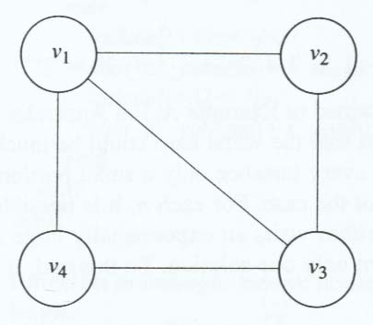
3-Coloring Problem
CSG523/ Desain dan Analisis Algoritma

Slide 43
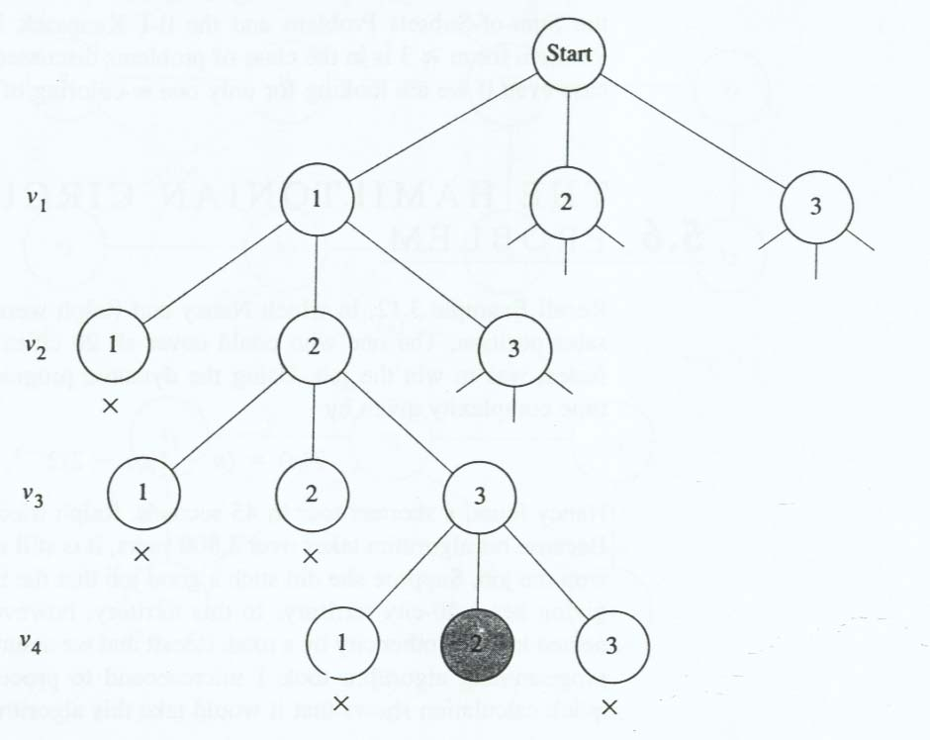
3-Coloring Problem
CSG523/ Desain dan Analisis Algoritma

Slide 44
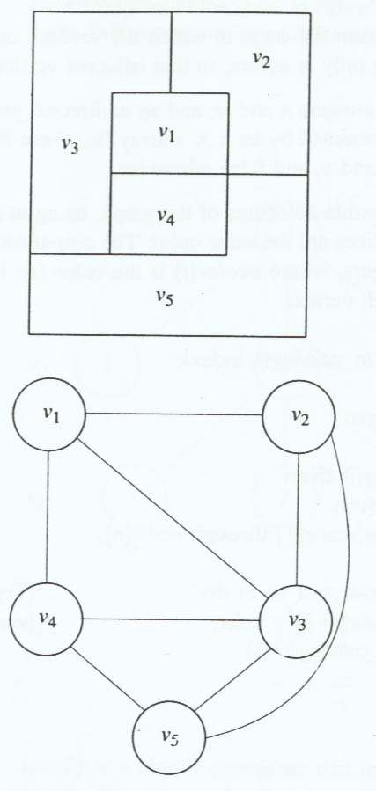
Application: coloring the map
CSG523/ Desain dan Analisis Algoritma

Slide 45
The m-Coloring Graph Algorithm
Procedure m_coloring(i:index);
Var color: integer
Begin
if promising(i) then
if i=n then
write(vcolor[i] through vcolor[n])
else
for color:= 1 to m do
vcolor[i+1]:=color;
m_coloring(i+1)
end
end
end
End;
CSG523/ Desain dan Analisis Algoritma

Slide 46
The m-Coloring Graph Algorithm
function promising(i:index):boolean;
Var j:index;
Begin
j:=1;
promising:=true;
while j<i and promising do
if W[i,j] and vcolor[i]=vcolor[j] then
promising:=false
end
j:=j+1
end
End;
CSG523/ Desain dan Analisis Algoritma

Slide 47
The m-Coloring Graph Algorithm
Top level call to m_coloring is:
m_coloring(0);
Size of the complete search space:
CSG523/ Desain dan Analisis Algoritma

Slide 48
Exercises
Use the backtracking algorithm for the 0/1 Knapsack Problem. Compare the result with that of dynamic programming.
Compare the performance of the backtracking algorithm and greedy algorithm for the m-Coloring problem.
List applications of m-Coloring problem
Modify the backtracking algorithm for N-queens and m-Coloring problem, instead of generating all possible solutions, it only finds a single solution.
CSG523/ Desain dan Analisis Algoritma

