Slide 1
CSG5F3/ Desain dan Analisis Algoritma
Lecture 1 : Introduction to Software Engineering Concepts
Intelligence, Computing, Multimedia (ICM)

Slide 2
Outline
Administration Issue
Syllabus
Top-down & bottom-up programming
Correctness proofs by Induction
Transforming & optimizing programs

Slide 3
DATA DOSEN
Nama/Kode: Febryanti Sthevanie St., MT/FSV
Kelompok Keahlian : ICM
Spesialisasi : Multimedia bidang Image Processing, Video Processing, Computer Vision
Pengalaman Mengajar : Daspro, Alstrukdat, PBO, Pengolahan Citra
No Hp/Email : 085284710177/ febryantisthevanie@gmail.com
Ruangan : Gedung E. Lantai 1. Ruang Dosen 109
No HP Ketua Kelas IF 01 : Keri : 085647900295

Slide 4
Rules
TITIP ABSEN, PLAGIARISME/MENCONTEK/KECURANGAN = E
NO LAPTOP IN MY CLASS (kecuali diminta)
Tidak menggunakan seragam sesuai aturan = TIDAK BOLEH MASUK KELAS
TUGAS dan KUIS SUSULAN hanya berlaku bagi yang :
SAKIT : bukti surat dokter
KEPERLUAN PENTING KELUARGA : bukti Surat Keterangan dari Ortu
Penugasan dari Kampus : bukti surat tugas dari kampus
Notes:
Aturan perkuliahan
Reward and punishment

Slide 5
About DAA This Semester
Tiga (3) sks, yaitu 3 jam teori + 1 jam responsi
Dosen : RMB, FSV, KNR, GIA, RSM, SRV, MUB
Sistem Penilaian
Item-item | bobot
Quiz | 10%
Tugas besar | 20%
UTS | 30%
UAS | 40%

Slide 6
Tujuan Instruksional Umum
Setelah mengikuti kuliah ini, mahasiswa diharapkan memahami teknik untuk menganalisis algoritma dan teknik untuk memecahkan masalah secara mangkus (efisien) sesuai dengan karakteristik masalah tersebut.

Slide 7
Tujuan Instruksional Khusus
Mahasiswa mampu:
Menggunakan kakas matematika untuk menganalisis kemangkusan algoritma.
Memilih teknik yang tepat untuk menyelesaikan masalah sesuai dengan karakteristik masalah tersebut
Membuat program aplikasi untuk menyelesaikan masalah dengan strategi yang tepat.

Slide 8
Daftar Pustaka
Introduction to Algorithms, 2nd edition
T. H. Cormen, C. E. Leiserson, R. L. Rivest, and Clifford Stein. Published by: MIT Press or McGraw-Hill
Introduction to the design and analysis of algorithm
Anany Levitin. Published by: Addison Wesley 2003
Foundations of algorithms
Richard Neapolitan. Kumarss Naimipour. Published by D.C Heath and Company 1996
Referensi
Diktat Strategi Algoritmik IF2251
Ir. Rinaldi Munir, M.T. Departemen Teknik Informatika, Institut Teknologi Bandung

Slide 9
Prasyarat
UTAMA : TIDAK MUDAH MENYERAH
Dan...Mahasiswa sudah mengambil mata kuliah:
Matematika diskrit (Topik: himpunan, relasi dan fungsi, kombinatorial, graf, pohon).
Algoritma dan struktur data (Topik: algoritma, pemrograman (Pascal/C/Java), struktur data (senarai, pohon, graf).
A little bit knowledge about Kalkulus ^_^

Slide 10
PRASYARAT DETAIL
Basic programming
Loops
Pointers
recursion
Discrete Mathematic
Induction
Permutation
Sets
Probability
Calculus
Logarithms
Integration
Differentiation
Data Structure
Stack
List
Queue
Heaps
trees

Slide 11
Pokok-pokok kuliah
1. Correctness
2. Analisis algoritma
a. Kompleksitas waktu/ruang
b. Kompleksitas waktu asimptotik (notasi O, Ω, Θ)
3. Teknik perancangan algoritma:
a. Algoritma Brute Force
b. Algoritma Greedy
c. Algoritma divide and conquer
d. Algoritma traversal di dalam graf (DFS, BFS)

Slide 12
Pokok-pokok kuliah cont’
e. Algoritma backtracking
f. Algoritma branch and bound
g. Dynamic Programming
4. Pencocokan string (pattern/string matching)

Slide 13
Important Problem Types
Sorting
Definition
why would we want a sorted list?
Properties of sorting: stable and in place
Searching
Sequential and binary search
Two or more operations: addition to, deletion from
String processing → string matching
Graph problem
For modelling communication network, event schedulling, games, topsort, TSP, graph-coloring.

Slide 14
Important (cont.)
Combinatorial problem
Combinatorial object: permutation, combination, subset
TSP, graph-coloring
Geometric problem
Deal with geometric object: line, point, polygon
Closest-pair problem, computer graphic (construct geometric shapes: triangle, circle)
Numerical problem
Mathematical object: solving equations, systems of equations, computing definite integrals, evaluating functions.

Slide 15
Analisis Algoritma
Algoritma tidak cukup hanya benar saja (correctness), tetapi juga harus mangkus (efisien)
Tujuan:
1. Mengukur efisiensi algoritma dari
segi waktu/ruang memori,
2. Membanding-bandingkan dua/lebih
algoritma untuk masalah yang sama.

Slide 16
Analysis Framework
Efficiency of algorithm:
Time efficiency
Space efficiency
Measuring an input’s size
Units for measuring running time
Basic operation
Examples: sorting algorithm, matrix multiplication, polynomial evaluation, multiplication of two numbers

Slide 17
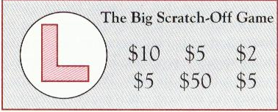
Top-down Programming
Consider the following example of a scratch-off lottery ticket

Slide 18
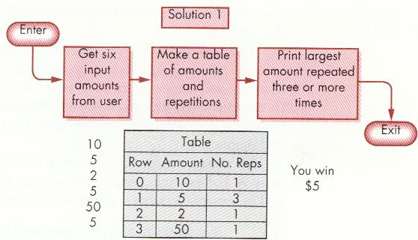
Top-down (cont’d)
Some possible solutions:
Make a table and search it to find the solution

Slide 19
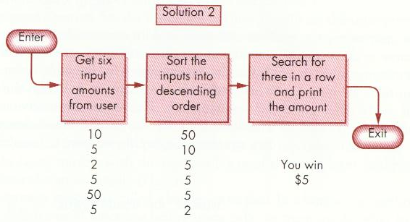
Top-down (cont’d)
Sort the input into descending order and find the first run of three repeated amounts

Slide 20
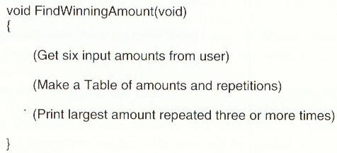
Top-down (cont’d)
Top level

Slide 21
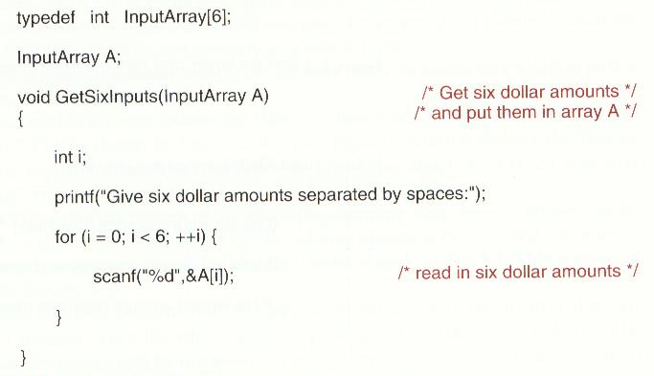
Top-down (cont’d)
Getting six inputs from the user

Slide 22
Top-down (cont’d)
First alternative is choosing the data structure for the table before designing the strategy for the algorithm
Second alternative is postponing the choice of data representation

Slide 23
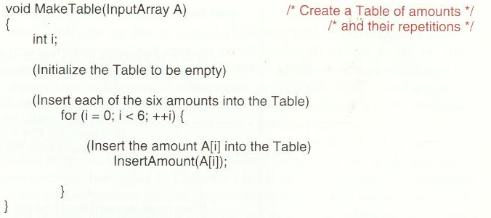
Top-down (cont’d)
It’s the second idea

Slide 24
Top-down (cont’d)

Slide 25
Top-down (cont’d)

Slide 26
Top-down (cont’d)
The activity of creating program at the top level leads to the creation of function calls, whose lower-level function definitions have not yet been written.

Slide 27
Bottom-up programming
Write the definitions of functions first before using calls on them inside other higher-level functions

Slide 28
Data structure for the table
typedef struct {
int Amount;
int Repetitions;
} RowStruct;
RowStruct Table[6];

Slide 29
Final program

Slide 31
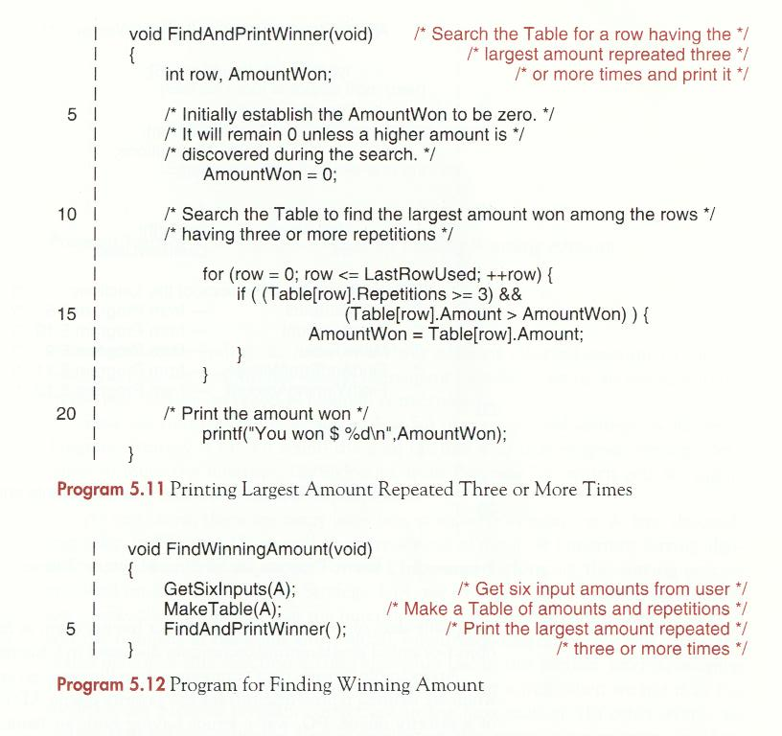

Slide 33
Review questions
What is the difference between top-down and bottom-up programming ?
What does it mean to postpone the choice of data representations and algorithms ?

Slide 34
Next Topic
CORRECTNESS
Tugas:
Pelajari Algoritma :
Selection Sort
Finding Max Value

Slide 35
CORRECTNESS

Slide 36
Proving Programs Correct
How to prove that a program does what it is intended to do
Providing assertions:
Precondition → Initial state
Postcondition → Final state
{precondition}
P
{postcondition}

Slide 37
Example: SelectionSort(A,m,n)
Still Remember?
By applying the pattern in the case of SelectionSort:
{m ≤ n}
SelectionSort(A,m,n)
{A[m]≥A[m+1] ≥… ≥A[n]}

Slide 38
Contoh pada Java

Slide 39
Proving correctness of SelectionSort
Place additional assertions inside the text of the SelectionSort program
Construct proofs of correctness of the subroutines used by SelectionSort

Slide 40
First, Proving FindMax
The pre and postcondition are:
{m<n} /*precondition*/
j=FindMax(A,m,n);
{A[j]≥A[m:n]} /*postcondition*/

Slide 41
Finding the position of the largest item

Slide 42
Mathematical Induction
i^{th} trip
Statement i++
i=m+1
j=m
Statement if (A[i]>A[j]) j=i
A[j]≥A[m:m+1] → A[j] ≥A[m:i]
If (m<n) and (i=m+1), then (i≤n)
∴ Loop invariant A[j]≥A[m:i] Λ (i≤n) → true

Slide 43
(i+1)^{st} trip
Test the while-condition (i!=n), suppose it is still true, so we have two facts:
(i ≠ n)
A[j]≥A[m:i] Λ (i≤n)
→ by combining those two facts, the loop invariant assertion will yield: A[j]≥A[m:i] Λ (i<n)
after i++ is executed, another assertion: A[j]≥A[m:i-1] Λ (i≤n) must hold.
The statement if (A[i]>A[j]) j=i; is executed, the loop invariant assertion: A[j]≥A[m:i] Λ (i≤n) still holds true

Slide 44
The principle of proving correctness program using induction:
If it’s true on any given trip, it will remain true on the next trip.
Consequently,
It’s true on every trip through the loop

Slide 45
Finishing the proof
We are now ready to go back and prove that SelectionSort(A,m,n) sorts A[m:n], using the fact we just establish that j=FindMax(A,m,n)
We can add assertions in SelectionSort(A,m,n) as follows :

Slide 46
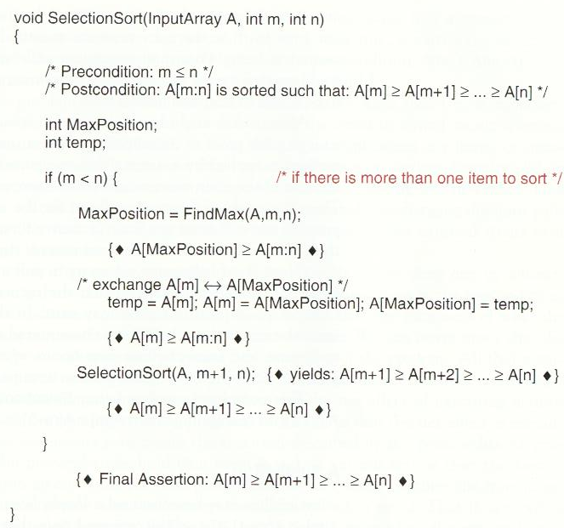
Finishing the proof

Slide 47
Outer Subproblem
Assume condition (m<n) is true
Function FinMax(A,m,n) is called, so we have assertion A[MaxPosition] ≥ A[m:n] (line 14)
Meaning A[MaxPosition] is the largest item in the subarray A[m:n]
Statement exchange A[m] – A[maxPosition]
A[m] = subarray’s first item
A[MaxPosition] = subarray’s largest item
After axchange, A[m] is the largest item in A[m:n]
→ so we have assertion A[m] ≥ A[m:n] (line 19)

Slide 48
Smaller subproblems
Recursive call SelectionSort(A,m+1,n)
Effect : rearranging the items in A[m+1:n] into decreasing order so we have assertion
A[m+1]≥ A[m+2]≥… ≥A[n] (line 21)
So we have 2 facts :
A[m] ≥ A[m+1]
A[m+1]≥ A[m+2]≥… ≥A[n]
→ yields : A[m] ≥ A[m+1]≥ A[m+2]≥… ≥A[n] (line 27)
if condition (m,n) on line 10 was false, combining the falsehood (m<n) with precondition (m≤n) on line 4, implies (m=n) must have been true.
A[m:m] only have 1 item, so there are no items to sort.

Slide 49
Recursion Induction
We used a second form of induction in constructing the proof of SelectionSort. This sometimes called RECURSION INDUCTION
This Method is applied by assuming that recursive calls on smaller-sized subproblem within the text of the main outer recursive function, correctly solve the smaller subproblem

Slide 50
Summary

Slide 51
Correctness of Nonrecursive
To prove P(n) is true for all n≥0:
First, prove P(0)
Then, assuming that P(n) is true for n, prove P(n+1) is true

Slide 52
Correctness of Nonrecursive

Slide 53
Correctness of Recursive
To prove P(n) is true for all n≥0:
Prove P(0)
Assuming P(k) is true for all 0≤k<n, prove P(n) is true

Slide 54
Correctness of Recursive

Slide 55
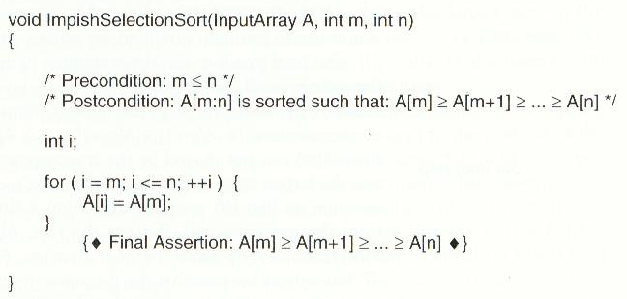
A subtle bug
Incomplete assertions !

Slide 56
Review questions
What is an assertion inside a program ?
What is a precondition ?
What is a postcondition ?
What is a correctness proof for a program ?

Slide 57
Exercise
What is the loop invariant inside the while-loop in the following program ? Prove it that it correctly computes the sum of the integers in the array A[1:n] !
int sum(Array A, int n) /* ass n>=0*/
{
int i=1, S=0;
while (i<=n){
S+=A[i];
i++;
}
return S;
}

Slide 58
Exercise

Slide 59
Exercise

Slide 60
Transforming & Optimizing Programs
Recursion elimination is converting a recursive program to an equivalent iterative program.
Transferring the parameters
Making call
Returning from the call

Slide 61
Program Transformations → exchange the laws that permit us to replace one form of a program with an equivalent form
Example:
If condition (i<n) is simpler than (i <= n && i != n)
Polynomial ((x + 3)*x + 5)*x + 2 is simpler than x*x*x + 3*x*x + 5*x + 2

Slide 62
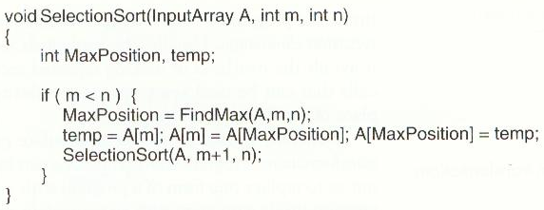
SelectionSort Elimination

Slide 63
Program transformation

Slide 66
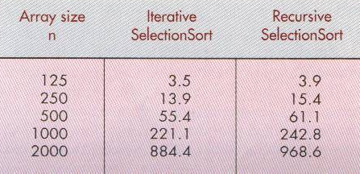
Iterative vs Recursive running time

Slide 67
Exercises
Eliminate the tail recursion from the following program
void RevString(char *S,int m,int n)
{
char c;
if (m<n){
c=S[m];S[m]=S[n];S[n]=c;
RevString(S,m+1,n-1);
}
}

Slide 68
Reference
Standish, Thomas A. Data structures, Algorithms, & Software Principles in C. Addison wesley publishing company. 1995

