Slide 1
CSG523/ Desain dan Analisis Algoritma
Dynamic Programming
Intelligence, Computing, Multimedia (ICM)

Slide 2
What is dynamic programming ?
The word programming stands for planning not for computer programming.
The word dynamic is related with the manner in which the tables used in obtaining the solution are constructed
CSG523/ Desain dan Analisis Algoritma

Slide 3
What is dynamic programming ?
Dynamic programming strategy is related with divide and conquer strategy because both of them are based on dividing a problem in subproblems. However there are some differences between these two approaches:
in decrease and conquer approaches the subproblems are usually independent so all of them have to be solved
in dynamic programming approaches the subproblems are dependent (overlapping) so we need the result obtained for a subproblem many times (so it is important to store it)
CSG523/ Desain dan Analisis Algoritma

Slide 4
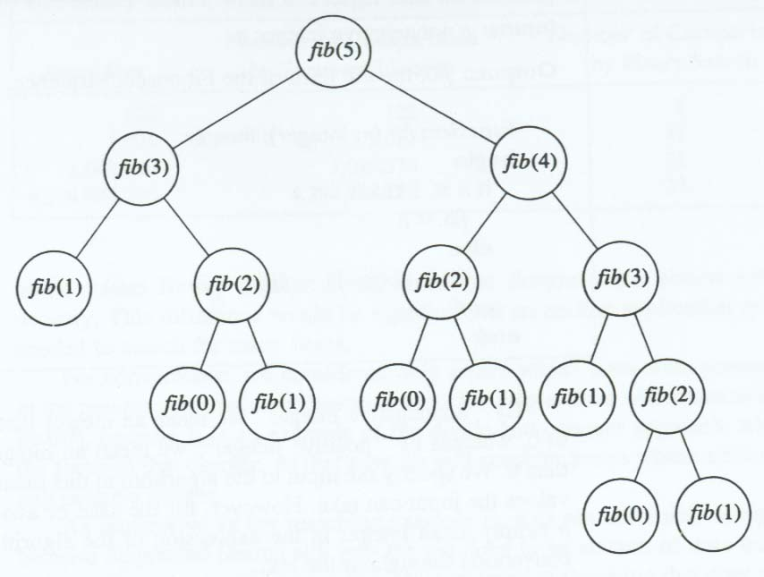
Top down approach illustration
CSG523/ Desain dan Analisis Algoritma

Slide 5
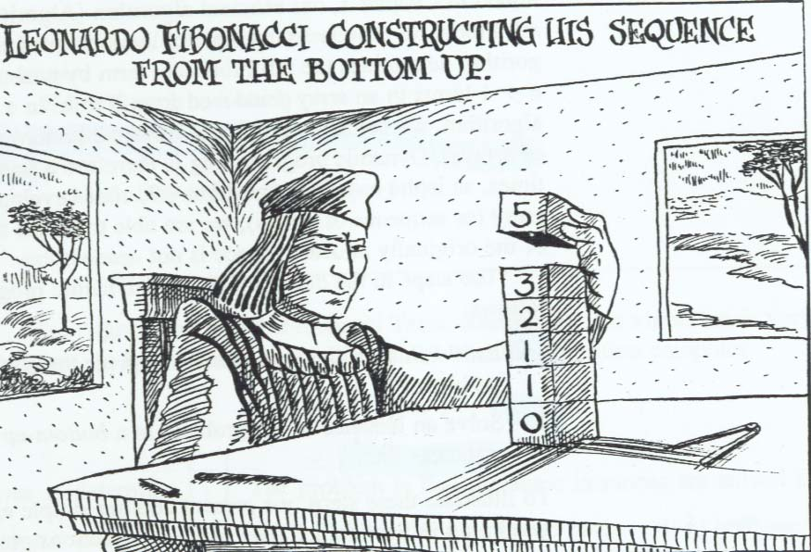
Bottom-up approach illustration
CSG523/ Desain dan Analisis Algoritma

Slide 6
The steps in the development of a dynamic programming
Establish a recursive property that gives the solution to an instance of the problem
Solve an instance of the problem in a bottom-up fashion by solving smaller instance first
CSG523/ Desain dan Analisis Algoritma

Slide 7
Application: Fibonacci
Algorithm 1 nth Fibonacci using Divide-and-Conquer
problem: determine the nth term in the fibo sequence
inputs: a nonnegative integer n
outputs: fib, the nth term of the fibo sequence
function fib(n:integer):integer;
begin
if (n=1) or (n=2) then
fib:=1
else
fib:=fib(n-1)+fib(n-2)
end
end;
Complexity ?
CSG523/ Desain dan Analisis Algoritma

Slide 8
Construction dynamic programming
Establish a recursive property in terms of F, it is

Slide 9
Solve the instance of the problem by computing the 1th and 2nd term of fibonacci sequence
Example. F[5]
Compute 1th term: F[1]=1
Compute 2nd term: F[2]=1
Compute 3rd term: F[3]=F[2]+F[1]=2
Compute 4th term: F[4]=F[3]+F[2]=3
Compute 5th term: F[5]=F[4]+F[3]=5
CSG523/ Desain dan Analisis Algoritma

Slide 10
The array F used to compute fibo
1 | 2 | 3 | 4 | 5 | 6 | … | n
1 | 1 | 2 | 3 | F[i-2] | F[i-1] | F[i]
CSG523/ Desain dan Analisis Algoritma

Slide 11
Complexity ?
Algorithm 2 nth Fibonacci using Dynamic Programming
problem: determine the nth term in the fibo sequence
inputs: a nonnegative integer n
outputs: fib2, the nth term of the fibo sequence
function fib2(n:integer):integer;
var
f: array[1..n] of integer;
i: index;
begin
f[1]:=1;
if n > 1 then
f[2]:=1;
for i := 3 to n
begin
f[i]:=f[i-1]+f[i-2]
end
end
fib2:=f[n];
end;
CSG523/ Desain dan Analisis Algoritma

Slide 12
Exercises: binomial coefficient
Computing a binomial coefficient C(n,k)
1 if k=0 or n=k
C(n,k)=
C(n-1,k)+C(n-1,k-1) otherwise
Efficiency:
Problem size: (n,k)
Dominant operation: addition
T(n,k) >= 2 ^{min{k,n-k}}
T(n,k) Є Ω(2 ^{min{k,n-k}} )
Top-down approach:
comb(n,k)
IF (k=0) OR (n=k) THEN
RETURN 1
ELSE
RETURN comb(n-1,k)+comb(n-1,k-1)
CSG523/ Desain dan Analisis Algoritma

Slide 13
Exercises: Construct a bottom-up approach
?
CSG523/ Desain dan Analisis Algoritma

Slide 14
Answer: binomial coef.
Computing a binomial coefficient C(n,k)
1 if k=0 or n=k
C(n,k)=
C(n-1,k)+C(n-1,k-1) otherwise
Bottom-up approach: constructing the Pascal’s triangle
0 1 2 … k-1 k
0 1
1 1 1
2 1 2 1
…
k 1 … 1
…
n-1 1 C(n-1,k-1) C(n-1,k)
n 1 C(n,k)

Slide 15
Answer: binomial coef.
Algorithm:
Comb(n,k)
FOR i:=0,n DO
FOR j:=0,min{i,k} DO
IF (j=0) OR (j=k)
THEN C[i,j]:=1
ELSE
C[i,j]:=C[i-1,j]+C[i-1,j-1]
RETURN C[n,k]
Efficiency:
Problem size: (n,k)
Dominant operation: addition
T(n,k)=(1+2+…+k-1) +(k+…+k)
=k(k-1)/2+k(n-k)
T(n,k) Є Θ(nk)
CSG523/ Desain dan Analisis Algoritma

Slide 16
Exercises: binary search
What is the best approach for this algorithm ?
CSG523/ Desain dan Analisis Algoritma

Slide 17
Dynamic Programming (optimization problem)
CSG523/ Desain dan Analisis Algoritma

Slide 18
Dynamic programming is also related to greedy strategy since both of them can be applied to optimization problems which have the property of optimal substructure
CSG523/ Desain dan Analisis Algoritma

Slide 19
The steps in the development of a dynamic programming
Establish a recursive property that gives the optimal solution to an instance of the problem.
Compute the value of an optimal solution in a bottom-up fashion.
Construct an optimal solution in a bottom-up fashion.
CSG523/ Desain dan Analisis Algoritma

Slide 20
The principle of optimality
It is said to apply in a problem if an optimal solution to an instance of a problem always contains optimal solution to all subinstances.
Dynamic programming may be used only when the principle of optimality holds.
CSG523/ Desain dan Analisis Algoritma

Slide 21
Application: discrete knapsack
Hypothesis:
the capacity C and the dimensions d₁,…,d_{n} are natural numbers
The problem can be reformulated as:
find (s₁,s₂,…,s_{n}) with s_{i} in {0,1} such that:
s₁d₁ +…+ s_{n}d_{n} <= C (constraint)
s₁p₁ +…+ s_{n}p_{n} is maximal (optimization criterion)
Remark
the greedy technique can be applied but it does not guarantee the optimality
CSG523/ Desain dan Analisis Algoritma

Slide 22
Example: n=3,
C=5,
d1=1, d2=2, d3=3
p1=6, p2=10, p3=12
Relative profit:
pr1=6, pr2=5, pr3=4
Greedy idea:
Sort decreasingly the set of objects on the relative profit (pi/di)
Select the elements until the knapsack is overloaded
Greedy solution: (1,1,0)
Total value: V=16
Remark: this is not the optimal solution; the solution (0,1,1) is better since V=22
CSG523/ Desain dan Analisis Algoritma

Slide 23
Analyzing the structure of an optimal solution
Let P(i,j) be the generic problem of selecting from the set of objects {o1,…,oi} in order to fill in a knapsack of capacity j.
Remarks:
P(n,C) is the initial problem
If i<n, j<C then P(i,j) is a subproblem of P(n,C)
Let s(i,j) be an optimal solution of P(i,j). There are two situations:
s_{i}=1 (the object o_{i} is selected) => this lead us to the subproblem P(i-1,j-d_{i}) and if s(i,j) is optimal then s(i-1,j-d_{i}) should be optimal
s_{i}=0 (the object oi is not selected) => this lead us to the subproblem P(i-1,j) and if s(i,j) is optimal then s(i-1,j) should be optimal
Thus the solution s has the optimal substructure property
CSG523/ Desain dan Analisis Algoritma

Slide 24
2. Find a recurrence relation
Let V(i,j) be the total value corresponding to an optimal solution of P(i,j)
0 if i=0 or j=0 (the set is empty or the knapsack has not capacity at all)
V(i,j) = V(i-1,j) if d_{i}>j or V(i-1,j)>V(i-1,j-d_{i})+ p_{i} (either the object i doesn’t fit the knapsack or by selecting it we obtain a worse solution than by not selecting it)
V(i-1,j-d_{i})+p_{i} otherwise

Slide 25
The recurrence relation can be written also as:
0 if i=0 or j=0
V(i,j) = V(i-1,j) if d_{i}>j
max{V(i-1,j), V(i-1,j-d_{i})+ p_{i} } if d_{i}<=j
Remarks:
for the problem P(n,C) the table V has (n+1) rows and (C+1) columns
V(n,C) gives us the value corresponding to the optimal solution

Slide 26
Example:
0 if i=0 or j=0
V(i,j) = V(i-1,j) if d_{i}>j
max{V(i-1,j), V(i-1,j-d_{i})+ p_{i} } if d_{i}<=j
d: 1 2 3 =weight
p: 6 10 12 = profit
V
0 1 2 3 4 5
0 0 0 0 0 0 0
1 0 6 6 6 6 6
2 0 6 10 16 16 16
3 0 6 10 16 18 22
Notes:
i sejumlah julah barang +1
J sejumlah max weight + 1

Slide 27
3. Developing the recurrence relation
0 if i=0 or j=0
V(i,j) = V(i-1,j) if d_{i}>j
max{V(i-1,j), V(i-1,j-d_{i})+ p_{i} } if d_{i}<=j
Algorithm:
computeV (p[1..n],d[1..n],C)
FOR i:=0,n DO V[i,0]:=0
FOR j:=1,n DO V[0,j]:=0
FOR i:=1,n DO
FOR j:=1,C DO
IF j<d[i] THEN V[i,j]:=V[i-1,j]
ELSE
V[i,j]:=max(V[i-1,j],V[i-1,j-d[i]]+p[i])
RETURN V[0..n,0..C]

Slide 28
Constructing the solution
Example:
0 1 2 3 4 5
0 0 0 0 0 0 0
1 0 6 6 6 6 6
2 0 6 10 16 16 16
3 0 6 10 16 18 22
Steps:
Compare V[3,5] with V[2,5]. Since they are different it means that the object o3 is selected
Go to V[2,5-d3]=V[2,2]=10 and compare it with V[1,2]=6. Since they are different it means that also o2 is selected
Go to V[1,2-d2]=V[1,0]=0. Since the current capacity is 0 we cannot select another object
Thus the solution is {o2,o3} or s=(0,1,1)
Notes:
V[2,5-d3] = V[objek kedua, 5(makx weight) – d3(berat barang pertama yang terambil)]
V[1,2-d2] = V[objek kedua, 2(sisa max weight) – (berat barang kedua yang terambil)

Slide 29
Constructing the solution
Example:
0 1 2 3 4 5
0 0 0 0 0 0 0
1 0 6 6 6 6 6
2 0 6 10 16 16 16
3 0 6 10 16 18 22
Algorithm:
Construct(V[0..n,0..C],d[1..n])
FOR i:=1,n DO s[i]:=0
i:=n; j:=C
WHILE j>0 DO
WHILE (i>1) AND (V[i,j]=V[i-1,j])
DO i:=i-1
s[i]:=1
j:=j-d[i]
i:=i-1
RETURN s[1..n]

Slide 30
Problem 1
Coin changing problem
By using coins of values {v₁,v₂,…,v_{n}} we want to find a subset of coins that total the amount C and the number of used coins is minimal
Let us suppose that v_{n} > v_{n-1} > … > v₁ =1
Example:
v1=1 v2=6 v3=10
C=12
Greedy solution: 10+1+1 (3 coins) Not optimal !
Better solution: 6+6 (2 coins)
CSG523/ Desain dan Analisis Algoritma

Slide 31
The generic problem P(i,j) asks for finding a minimal subset of {v₁,v₂,…,v_{i}} which covers the value j
An optimal solution of P(i,j) belongs to one of the classes:
It doesn’t use the coin v_{i} (it is identical to the optimal solution of P(i-1,j))
It uses the coin v_{i} (it contains an optimal solution of P(i,j-v_{i}))
Let R(i,j) be the number of coins corresponding to the optimal solution of P(i,j)
j if i=1
R(i,j)= 0 if j=0
R(i-1,j) if v_{i}>j
min{R(i-1,j),1+R(i,j- v_{i} )} otherwise
Let Q(i,j) in {0,1} be an indicator of the using of coin i in covering the value j

Slide 32
j if i=1
R(i,j)= 0 if j=0
R(i-1,j) if v_{i}>j
min{R(i-1,j),1+R(i,j- v_{i} )} if v_{i}<=j
Example: C=12, v: 10, 6, 1
0 1 2 3 4 5 6 7 8 9 10 11 12
1 0 1 2 3 4 5 6 7 8 9 10 11 12
2 0 1 2 3 4 5 1 2 3 4 5 6 2
3 0 1 2 3 4 5 1 2 3 4 1 2 2

Slide 33
0 if coin i is not used in the optimal solution of P(i,j)
Q(i,j)=
1 if coin i is used in the optimal solution of P(i,j)
Example:
0 1 2 3 4 5 6 7 8 9 10 11 12
1 0 1 1 1 1 1 1 1 1 1 1 1 1
2 0 0 0 0 0 0 1 1 1 1 1 1 1
3 0 0 0 0 0 0 0 0 0 0 1 1 0

Slide 34
0 1 2 3 4 5 6 7 8 9 10 11 12
1 0 1 2 3 4 5 6 7 8 9 10 11 12
2 0 1 2 3 4 5 1 2 3 4 5 6 2
3 0 1 2 3 4 5 1 2 3 4 1 2 2
0 1 2 3 4 5 6 7 8 9 10 11 12
1 0 1 1 1 1 1 1 1 1 1 1 1 1
2 0 0 0 0 0 0 1 1 1 1 1 1 1
3 0 0 0 0 0 0 0 0 0 0 1 1 0
The first value equal to one starting from bottom

Slide 35
Solution construction
Find the minimal value on the last column of R matrix which corresponds to a one in Q matrix
Go on the same line on the column placed v_{i} positions to the left and check if the corresponding value in Q is one …
CSG523/ Desain dan Analisis Algoritma

Slide 36
Construct(R[1..n,0..C],Q[1..n,0..C])
FOR i:=1,n DO S[i]:=0
imin=n
WHILE Q[imin,C]=0 DO imin:=imin-1
i:=imin
j:=C
WHILE j>0 AND i>0 DO
IF Q[i,j]=1 THEN S[i]:=S[i]+1
j:=j-v[i]
ELSE i:=i-1
IF j=0 THEN RETURN S[1..n]
ELSE “ it doesn’t exist a solution”
This can happen only if v[1]<>1
CSG523/ Desain dan Analisis Algoritma

Slide 37
Exercises
Compute the optimum solution for the following knapsack problem
C=30, n=3. Determine which items are inserted into the knapsack.
item | weight | Profit
1 | 5 | 50
2 | 10 | 60
3 | 20 | 140
CSG523/ Desain dan Analisis Algoritma

